Slide 1

APSIT MUSIC ZONE
Group members with Student Id
Kunal Palande 20104031
Aaswit Kanhed 20104083
Nishant Palav 20104055
Project Guide
Prof. Roshna Sangle

Slide 2
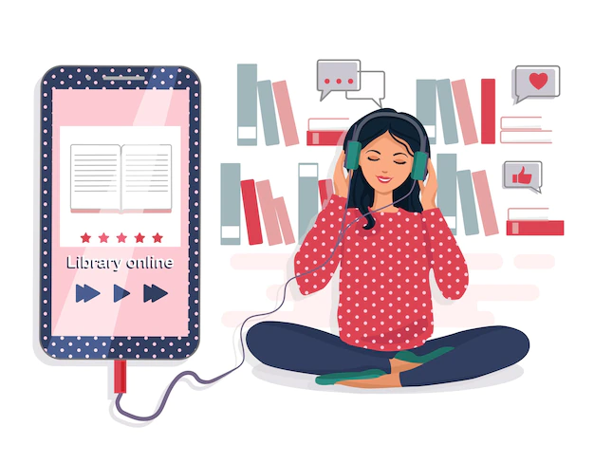
Mini Project 2A
Topic: APSIT MUSIC ZONE

Slide 3
Contents
Introduction
Objectives
Scope
Literature Survey
Proposed System
Project Outcomes
Block Diagram
Use Case/DFD
Technology Stack
Suggestions in Review-1
Result and Discussion
Conclusion and Future Scope
References

Slide 4
1. Introduction
Our Project is Apsit Music Zone which is a music player application where user can listen unlimited songs for free. The problems identified was Users can’t listen uninterrupted music as per their choice. Some applications have lot of advertisement which can be tedious for the users to listen music ad free. So the solution we proposed with this project is that the application is very convenient. The users can listen their favourite music whenever they want i.e. they can access out application 24/7. The next benefit is it is very cost-effective, it will save the users efforts as we have a very simple graphical user interface as well as we provide variety of content in this easy to use Apsit Music Zone – Your favourite destination for your favourite music.

Slide 5

2. Objectives
To build a user friendly web application
To listen add free songs without interruption
To easy access of favourite songs
To create a better music app clone
like google play, spotify, gaana,
amazon music, etc.

Slide 6
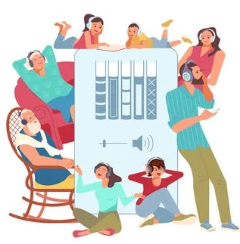
3. Scope
To reduce user’s searching time and effort.
To provide a wide collection of music.
Anyone can listen to our application like college faculties, students and any other individual.
Users can create their own profiles and add songs according to their choice.

Slide 7
Literature Survey
Literature Survey of Music System and Comparison with APSIT MUSIC ZONE
Year | Author | Title | Outcomes
2006 | Daniel Ek | Pandora Music Library | Pandora is a music streaming service marketed to individuals. It is billed as a legal and superior quality alternative to music piracy.
2019 | Martin Lorentzon | Spotify | Listening to music with premium features but contains ads.
2022 Aaswit Kanhed, Free to listen application which offers you
Nishant Palav, Apsit Music Zone uninterrupted listening of music and better
Kunal Palande gui as well as billions of songs with quality.

Slide 8
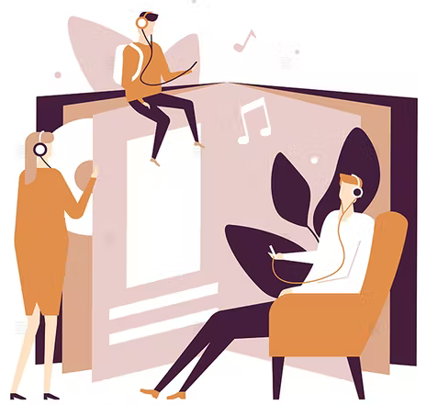
4. Feature /Functionality
Provision to play all kind of mp3 songs widely listened all over the world.
Create, save and modify playlists as the users want.
View the music library sorted by various aspects such as Artists, Album, Genre, Song Title, etc.
Easy and Simple User Interface.
Wide Songs availability since late 90’s to till
current songs.
Provides relaxation to the users and help them
to reduce their daily life stress and chill out
listening some music in their me time.

Slide 9

5. Outcome of Project
User can log in for free using Google, Facebook, Twitter, or as a Guest Login.
User can search for options available such as their playlists, new songs in the application.

Slide 10
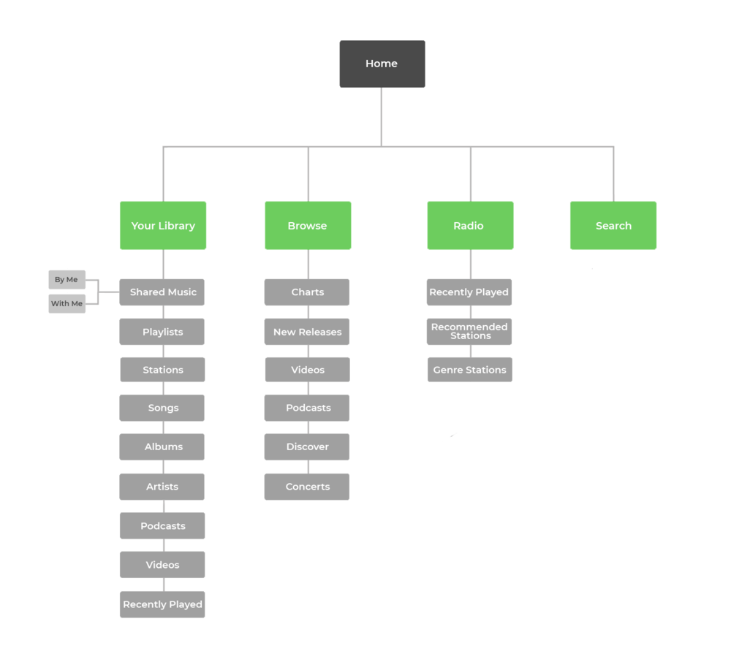
Flowchart

Slide 11
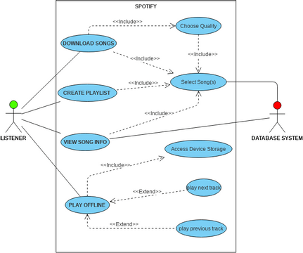
Use Case Diagram

Slide 12
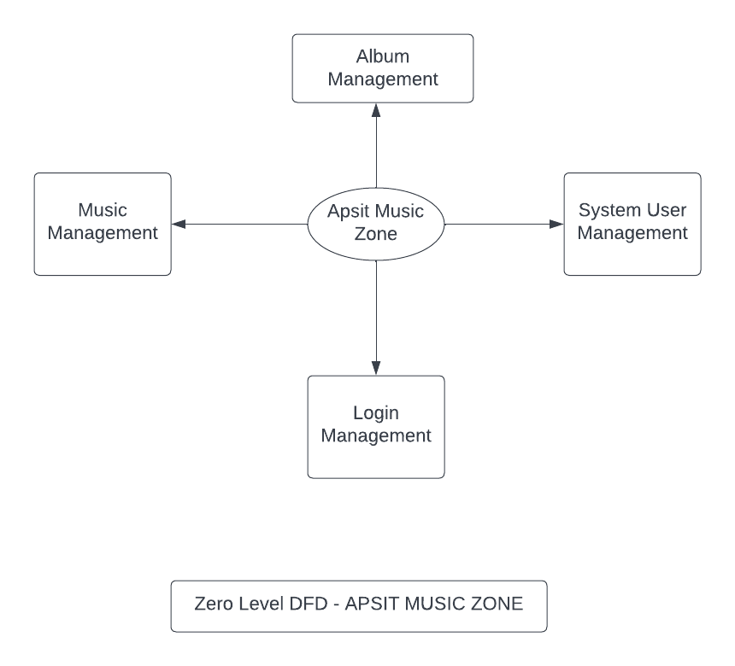
DFD Diagram
(Level 0)

Slide 13
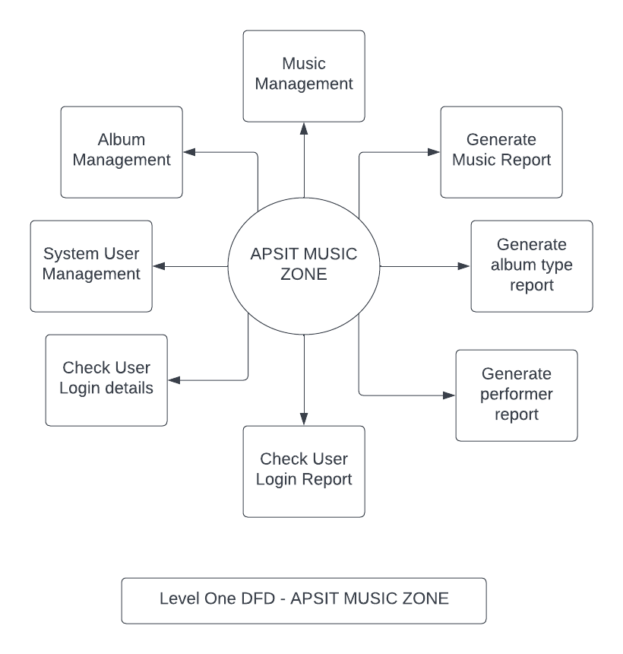
DFD Diagram
(Level 1)

Slide 14
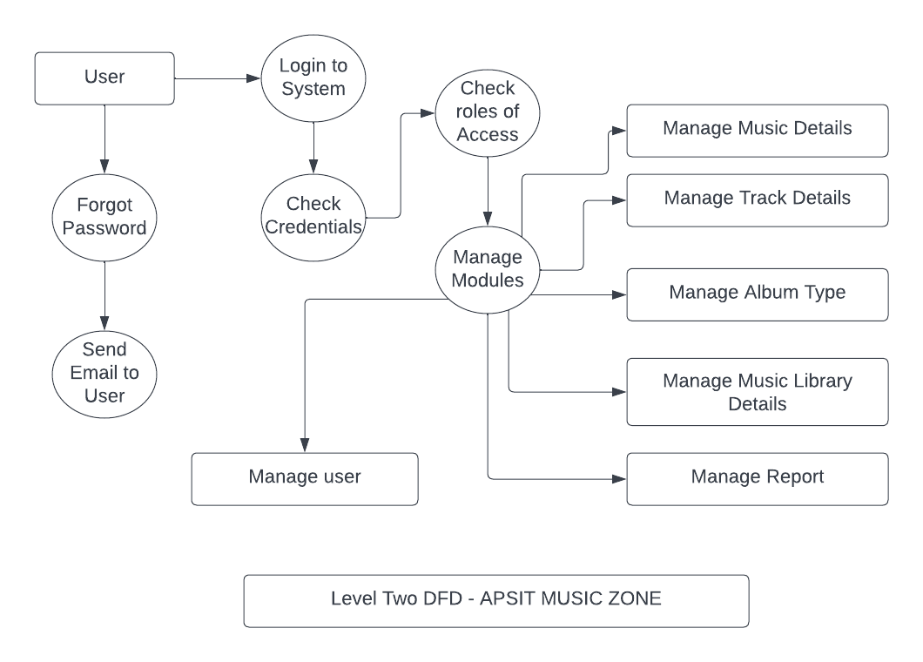
DFD Diagram
(Level 2)

Slide 15
6. Technology Stack
HTML 5
CSS 3
JAVASCRIPT 3
REACT JS
JSX

Slide 16
Suggestions in Review-1
Introduction must be in a paragraph.
Framing of sentences should be proper.
Changes in the Literature Survey.
DFD Diagram changes.
User Interface should be visible properly.
To see if we can add recommendation feature using Artificial Intelligence and Machine Learning.

Slide 17
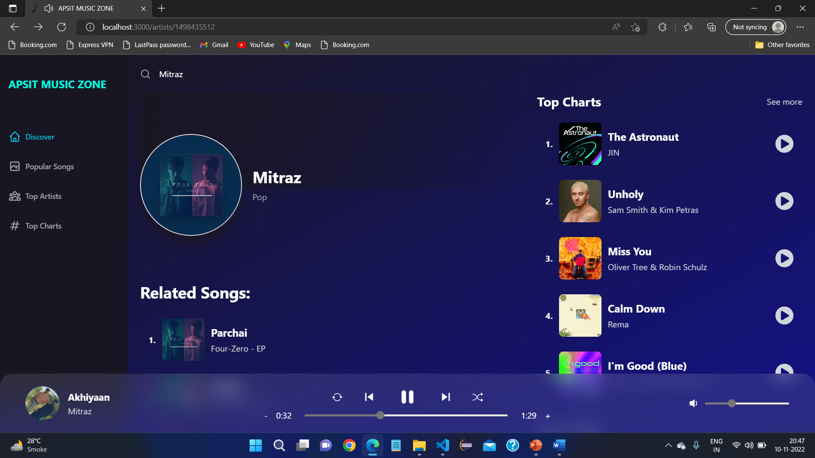
Result and Discussion
Discover Page which allows you to search your songs, artists, etc

Slide 18
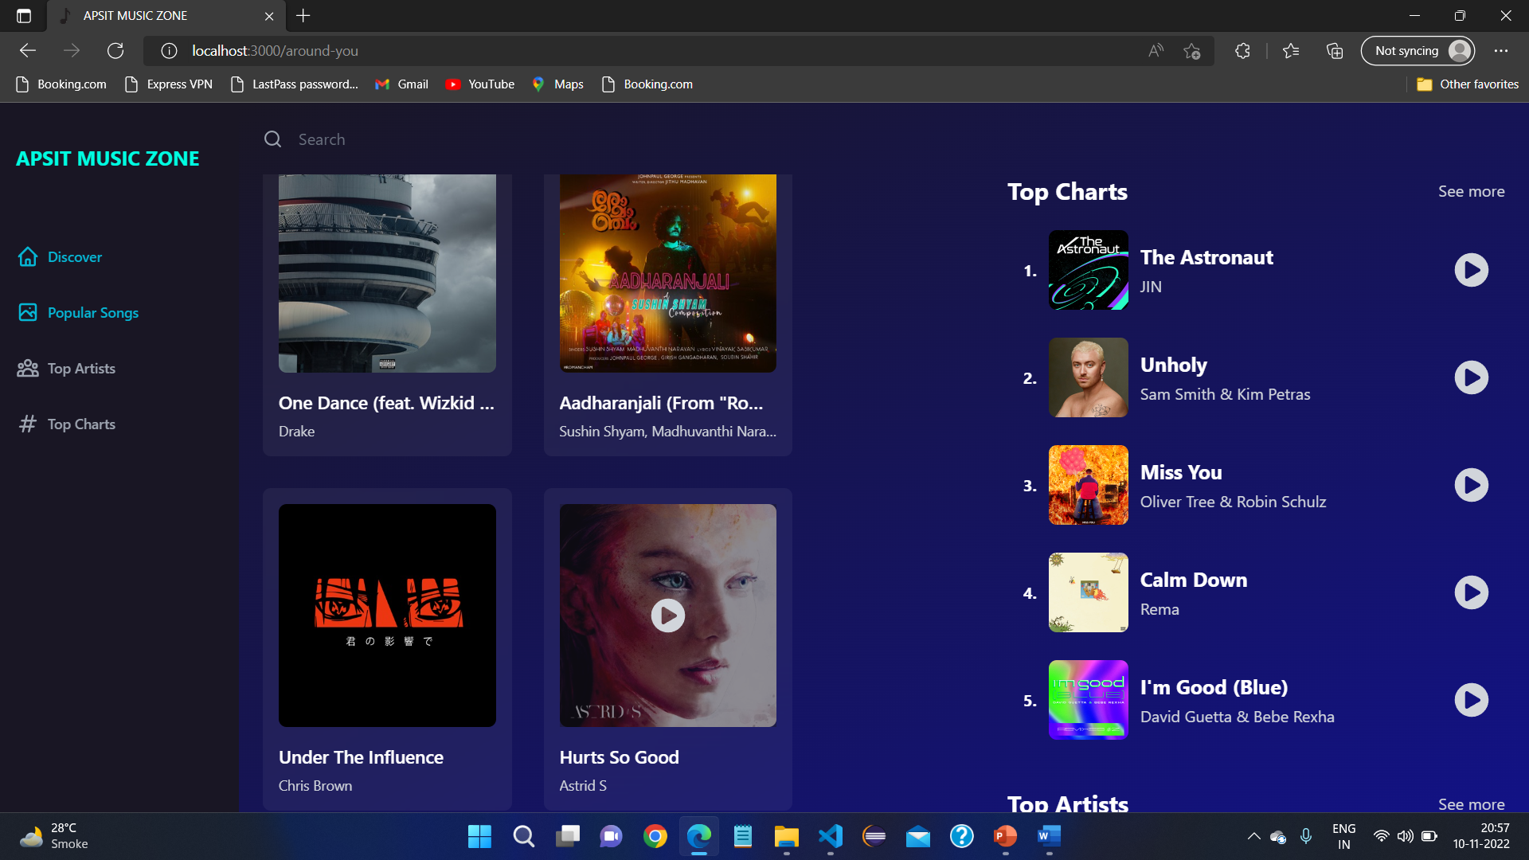
Popular Songs page where user can see the current popular songs of top artists

Slide 19
Conclusion
Built a user friendly music player which allows users to listen add free songs around the globe.
Listen unlimited songs of any language without interruptions with lyrics and artist name.
Future Scope
Future Scope of the Project is to add like and share feature.
Users will able to create their own playlist and download their favourite songs.

Slide 20
References
[1] Cisco, Visual Networking Index Traffic and Service Adoption Forecasts, Cisco, 2016.
[2] C. S. Jensen, M. R. Prasad, and A. Møller, “Automated testing with targeted event sequence generation,” in Proceedings of the 22nd International Symposium on Software Testing and Analysis (ISSTA ’13), pp. 67–77, ACM, Lugano, Switzerland, July 2013.
[3] A. R. Espada, M. M. Gallardo, and D. Adalid, “A runtime verication framework for android applications,” in XXI Jornadas de Concurrencia y Sistemas Distribuidos (JCSD ’13), 2013.
[4] A. R. Espada, M. M. Gallardo, A. Salmeron, and P. Merino, ´ “Using model checking to generate test cases for android applications,” in Proceedings of the 10th Workshop on Model Based Testing. Electronic Proceedings in Theoretical Computer Science, N. Pakulin, A. K. Petrenko, and B. H. Schlingloff, Eds., vol. 180, pp. 7–21, Open Publishing Association, 2015.
[5] A. R. Espada, M. Mar Gallardo, A. Salmeron, and P. Merino, ´ “Runtime verification of expected energy consumption in smartphones,” in Model Checking Software, vol. 9232 of Lecture Notes in Computer Science, pp. 132–149, Springer International Publishing, 2015.
[6] https://www.researchgate.net/publication/254960035_Spotify_review

Slide 21

Thank You...!!

